Slide 1
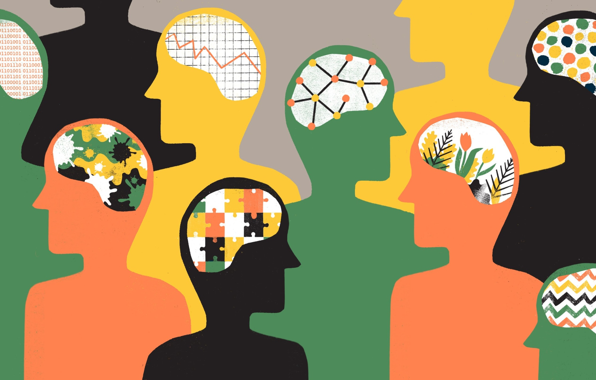
Personality Spectrum Analysis
- Shivesh Menon & Shivam Srivastav

Slide 2





Huge Amount Of Data:
Tracking
Analyzing
Human Behavior

Slide 3
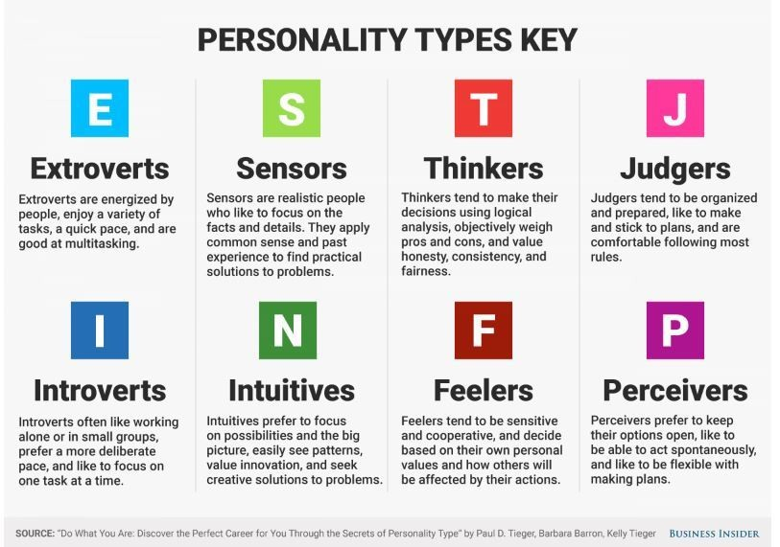
MBTI Personality Test

Slide 4
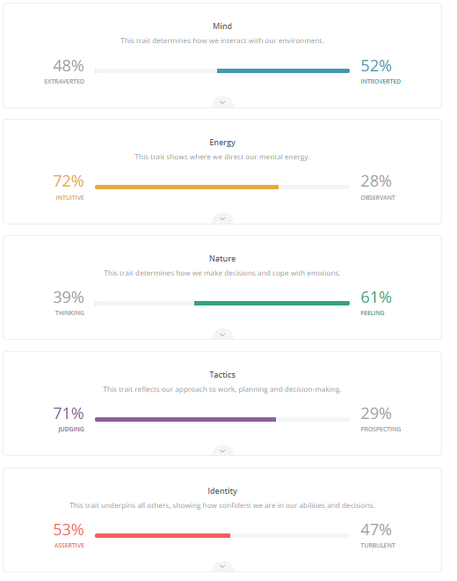

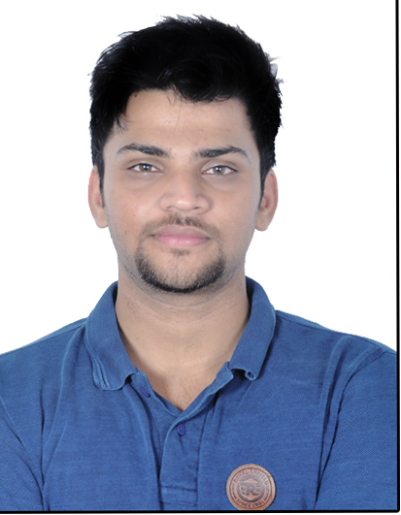
What are we?

Slide 5
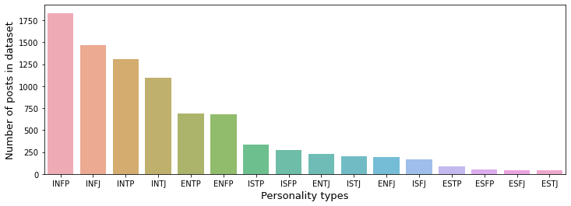
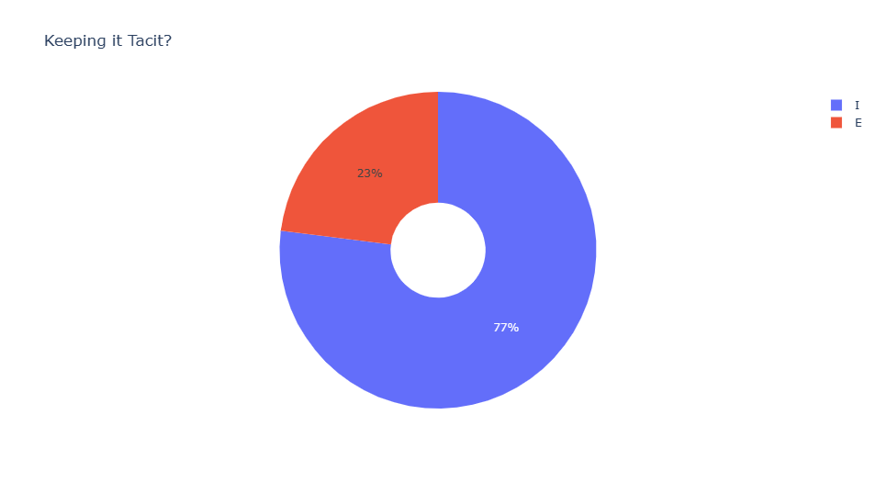
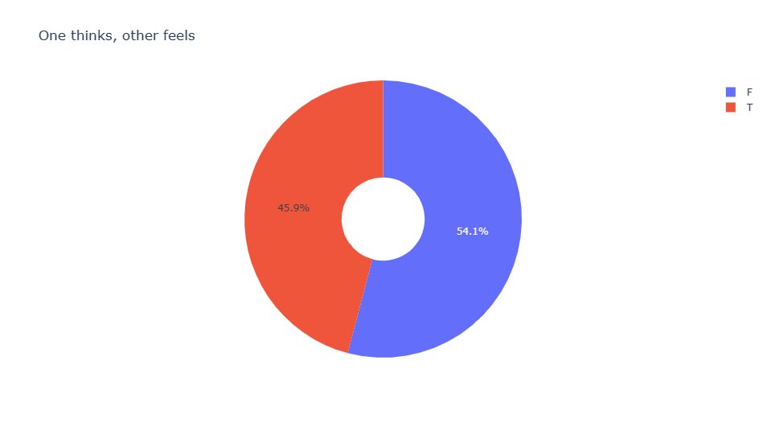
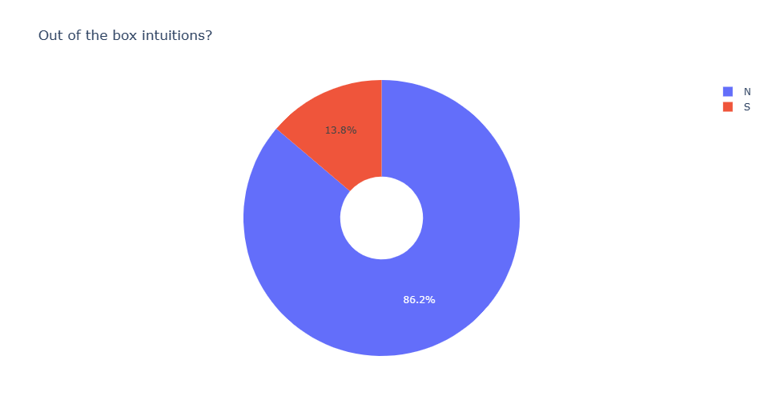
MBTI Dataset

Slide 6
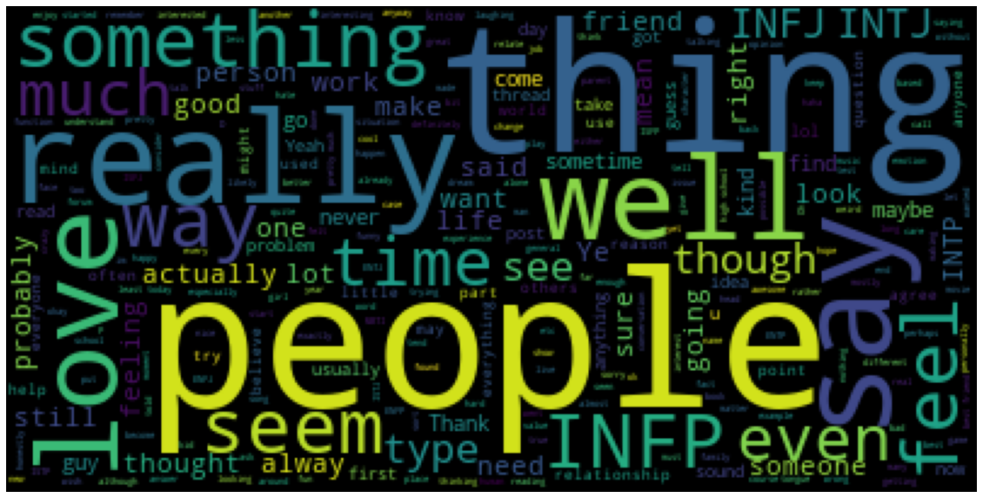
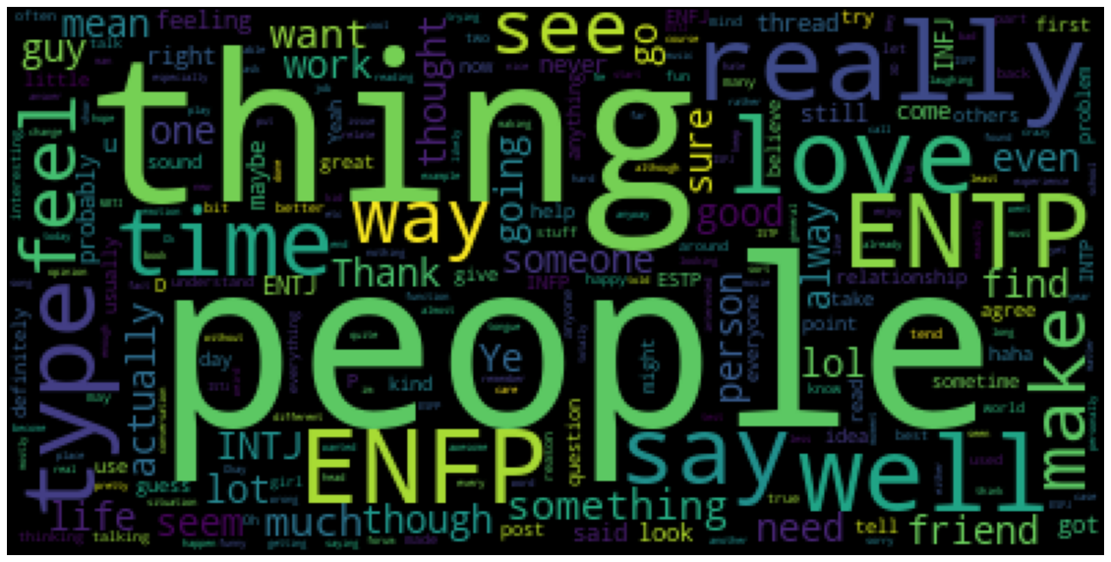
Word clouds – Natural Language Processing
Introvert
Extravert
Barring the most common words:-
Introverts tend to use more words such as “time”, “want”, “feel” and “love”
Extraverts have a tendency to use words such as “friends” and “say”.

Slide 7
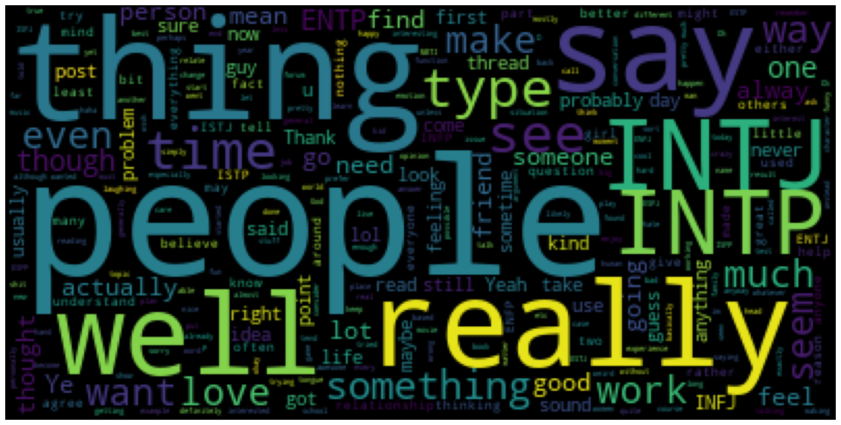
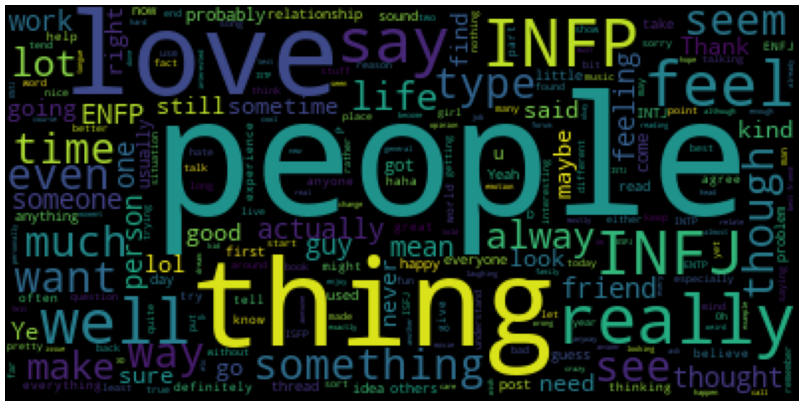
Word clouds – Natural Language Processing
Thinking
Feeling
Barring the most common words:-
Words like “love” and “feel” were most used by the people with Feeling trait which marked as clear differentiation among the two.

Slide 8
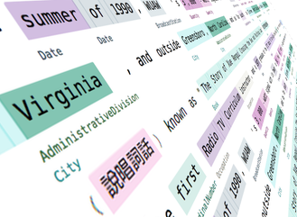
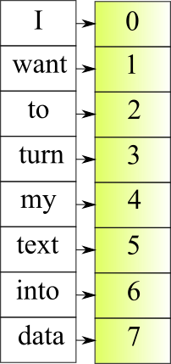
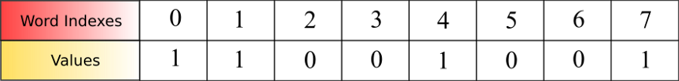
How to change text to features? - Vectorization
Text – “I want my data”

Slide 9
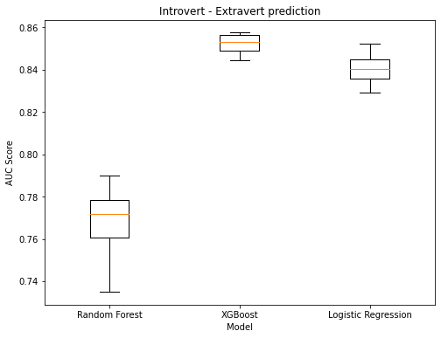
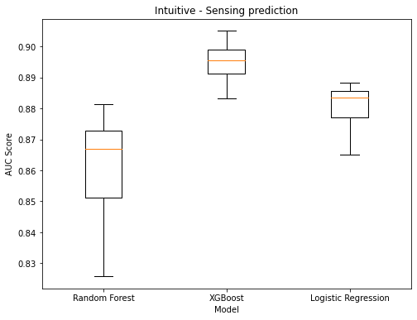
Introvert - Extrovert
Intuitive - Sensing
Random Forest score:0.7695690863315596
XG Boost score: 0.852161906198532
Logistic Regression score:0.8404617021809311
Random Forest score: 0.8620138567761071
XG Boost score: 0.8948119678072166
Logistic Regression score: 0.8802876098044535

Slide 10
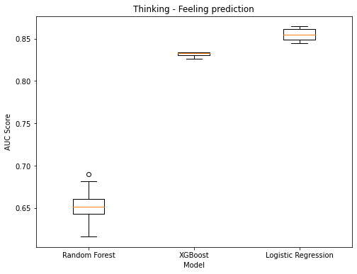
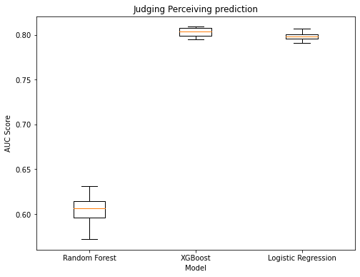
Thinking - Feeling
Judging – Perceiving
Random Forest score: 0.6505309903847688
XG Boost score: 0.8316424829591473
Logistic Regression score: 0.8549851417229574
Random Forest score: 0.6041489271230315
XG Boost score: 0.8029388873315302
Logistic Regression score: 0.7983285315438972

Slide 11

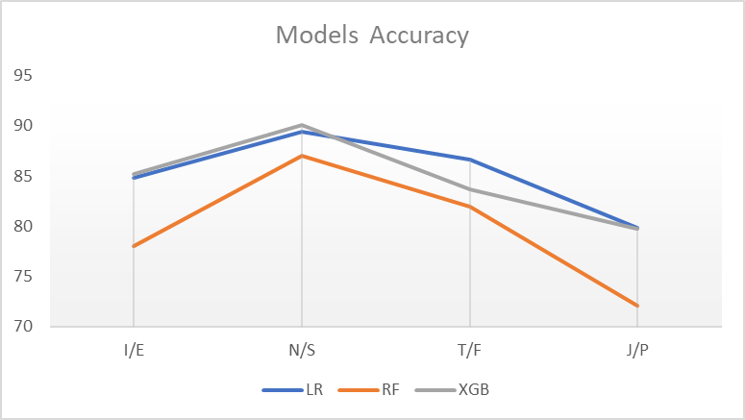
Machine Learning Models – Accuracy Comparison

Slide 12
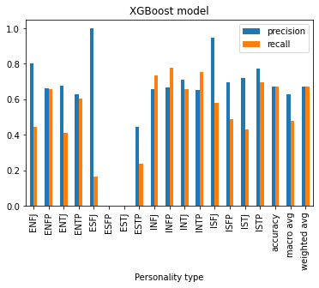
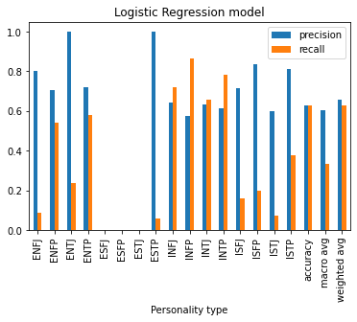
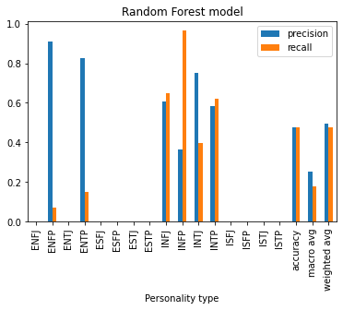
16 personality type classification

Slide 14
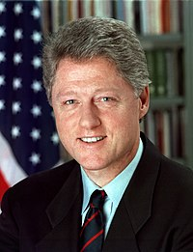
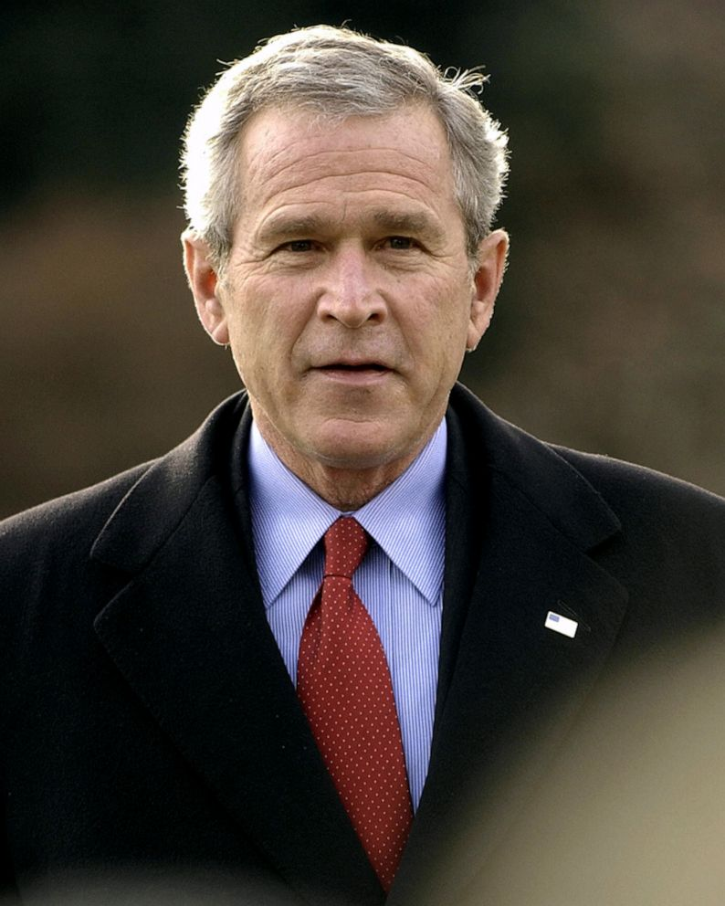
Too difficult to predict?
42nd US President - ESFP Personality
43rd US President - ESTJ Personality

Slide 15

Personality Analysis Look Ahead…….
The usage of ML methods in psychological research is expected to increase sharply in the near future.
Recruitment System
Personal Counselling System
User Personality Information
Bank Credit Scoring
Online Marketing
Criminal Investigation

